Slide 1
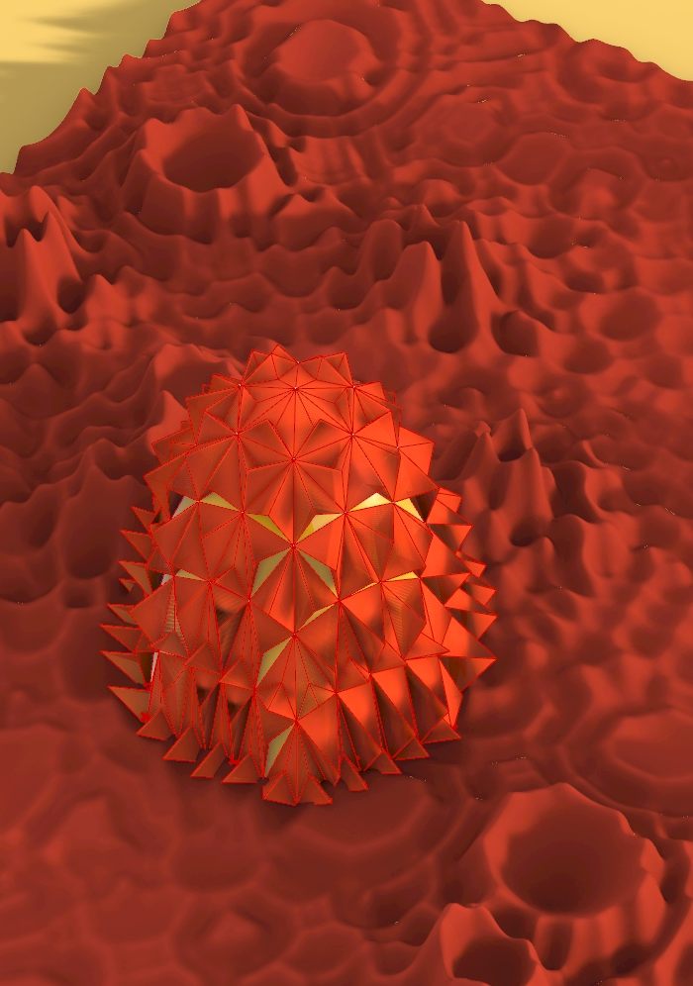
P#
<Computational Design Thinking>
<Generative Design>
P#
BEST PICTURE
Assignment
Context
Course
Date
Generative
Design
Freshmore
Term 1
Computational
Design Thinking
2020
Student
Following the ruin of Earth because of war, environmental, epidemiological and geological catastrophes, survivors fleeing from the crumbling human civilization now seek refuge in mars. They have created a massive inflatable settlement to house their inhabitants, fully equipped with housing, research facilities and agricultural areas.
To optimize the amount of material used in the construction of their new dwellings, they have opted for a hexagonal base for their settlement, as it has the best perimeter to floor surface area ratio. Furthermore, a hexagonal shape allows for future settlements to be propped up tessellated with it.
The inflatable mesh that the settlement is constructed with consists of rings of points along regular hexagons distributed along the radius of the structure.
Protection from radiation is offered by special deflective spikes, which reflect radiation away from the structure and into the surrounding terrain.
Lim Thian Yew
1003158
Instructor
Jason Lim
Lecturer

Slide 2
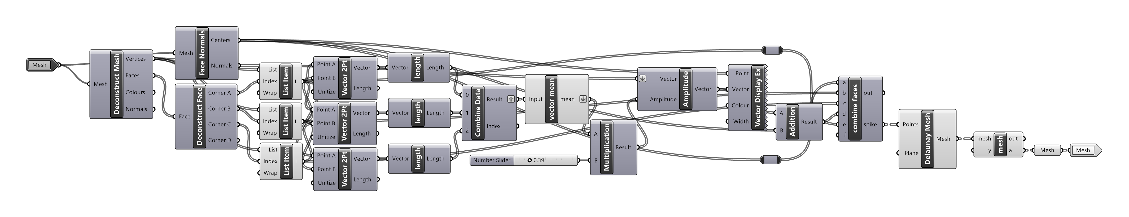
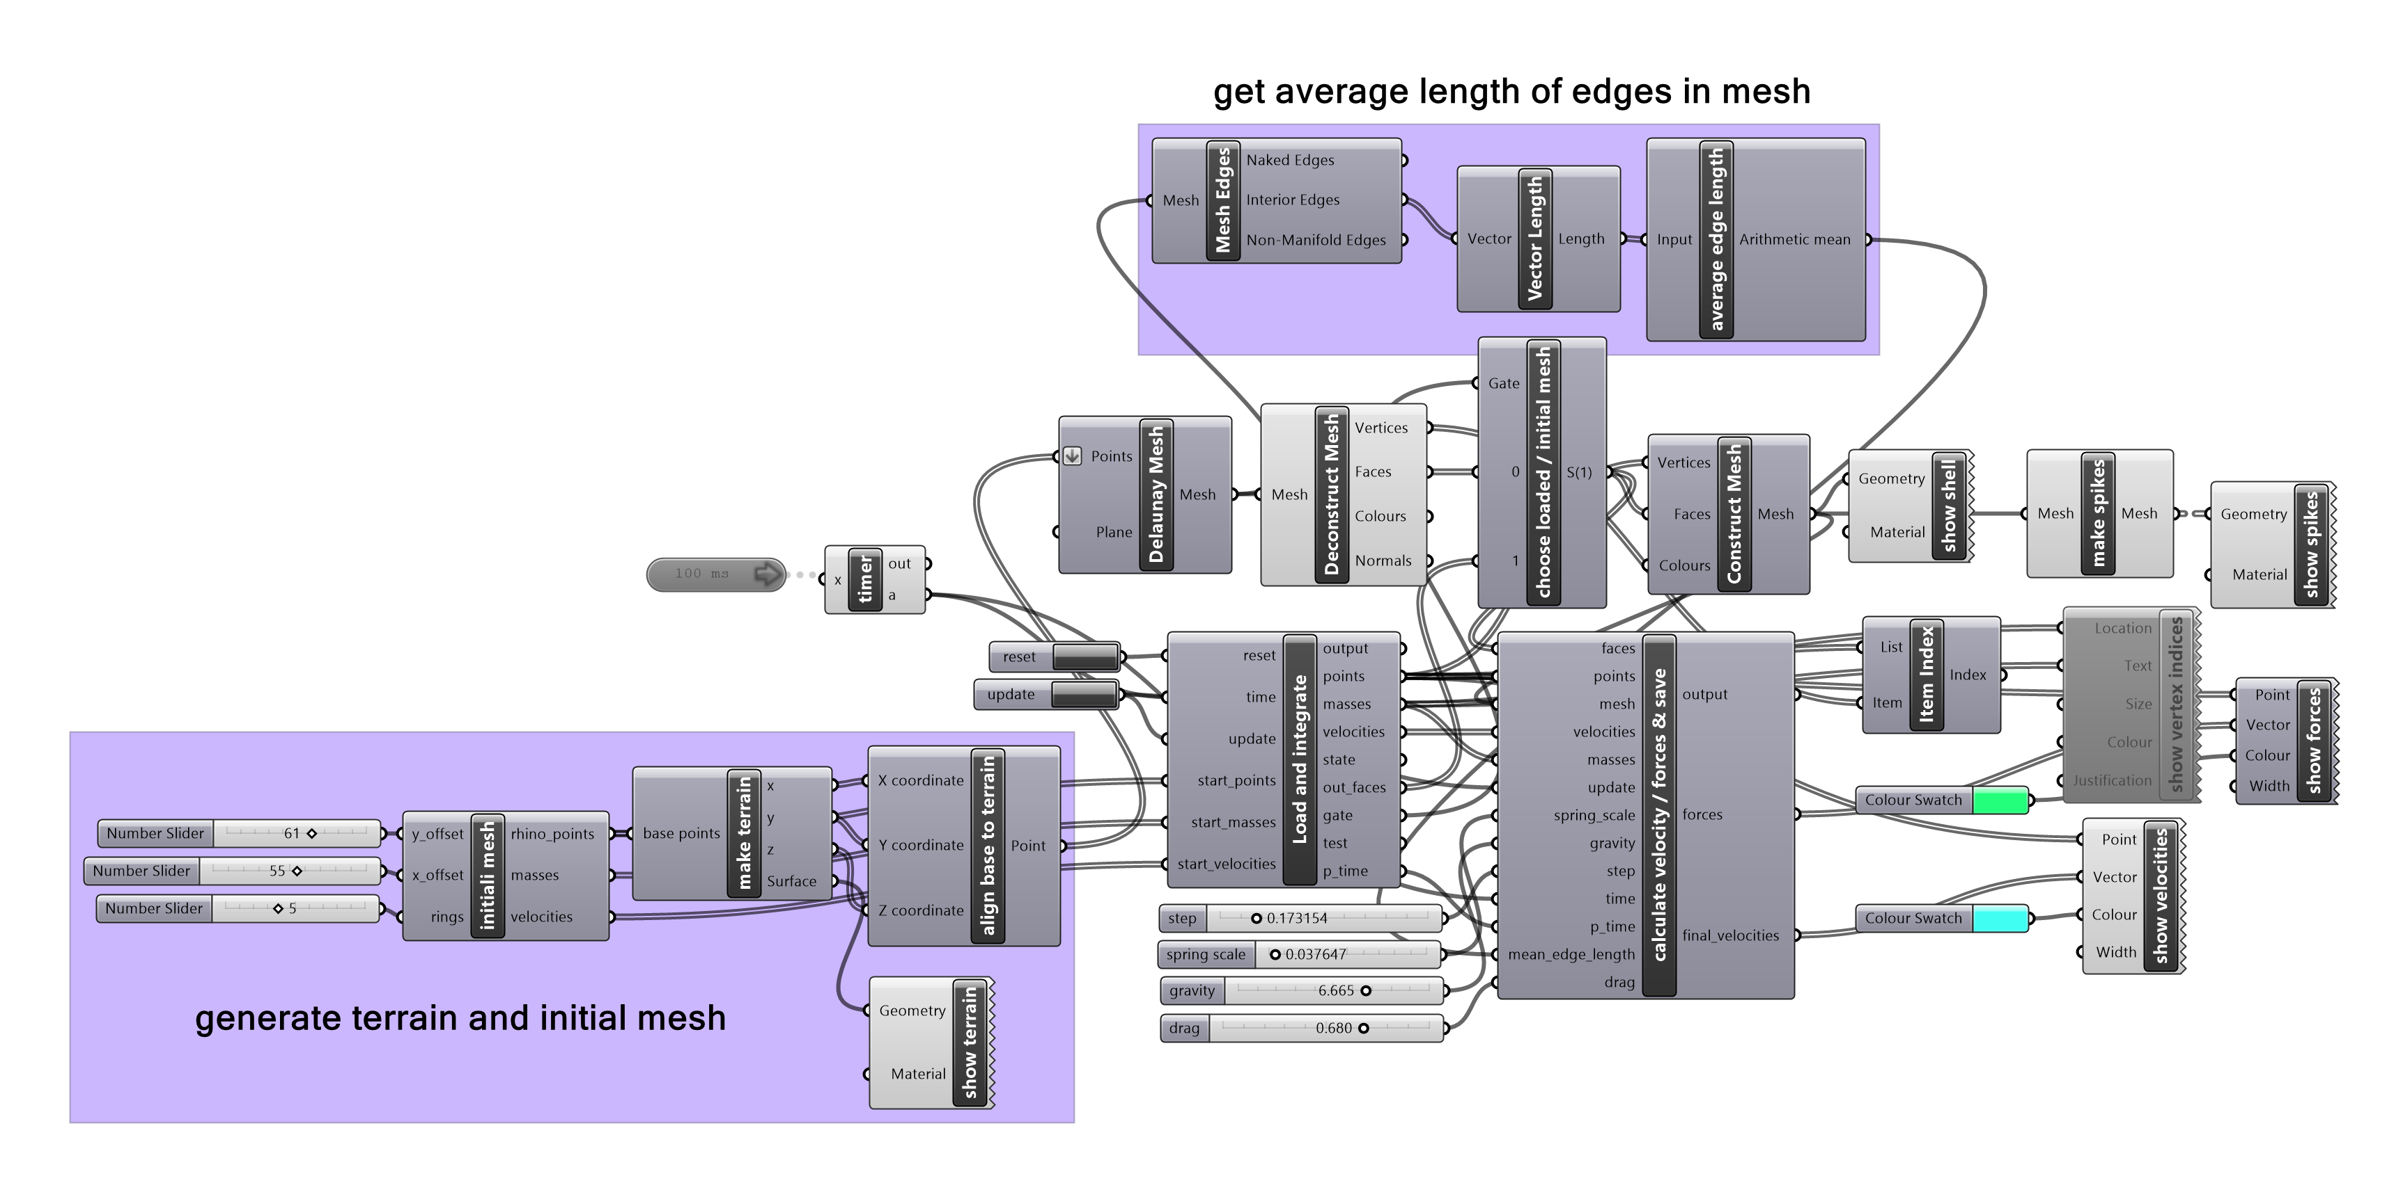
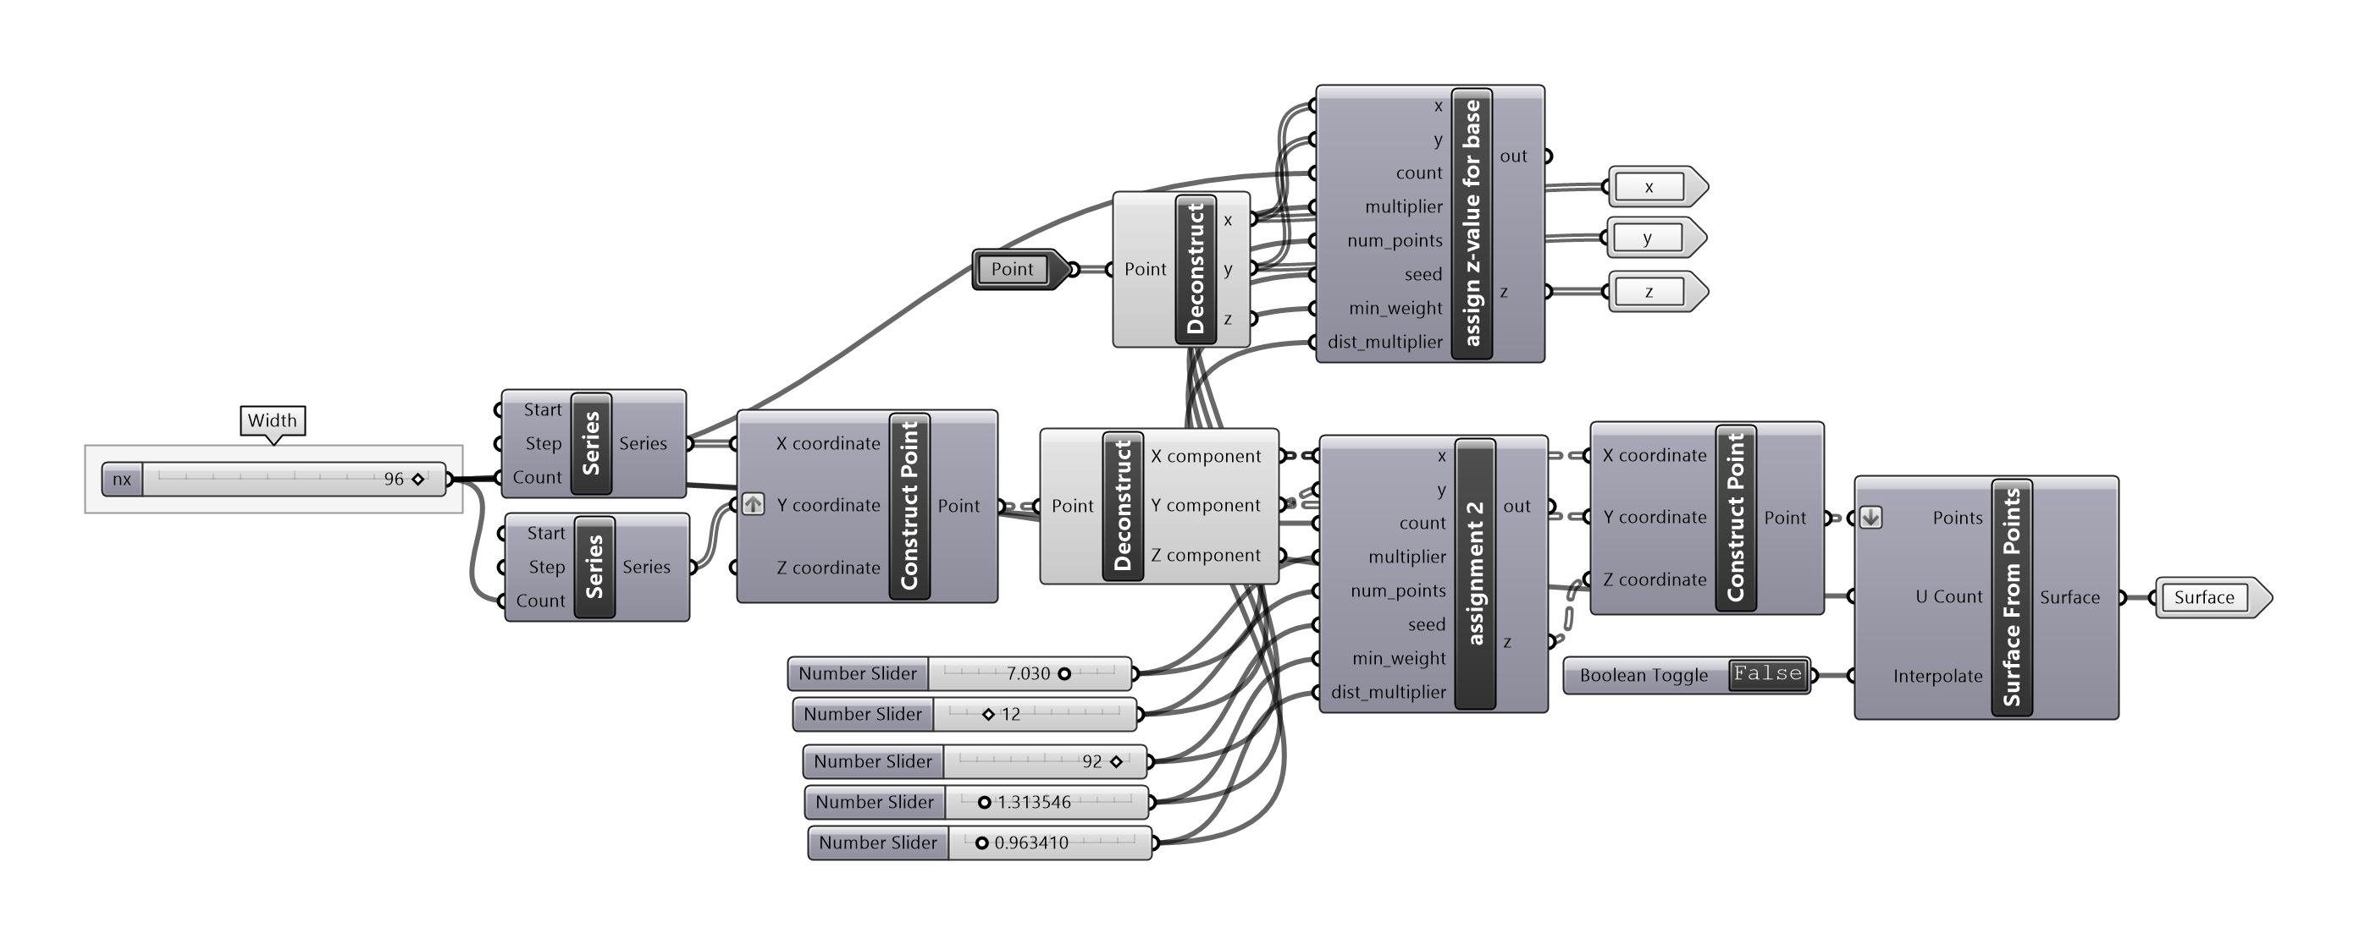
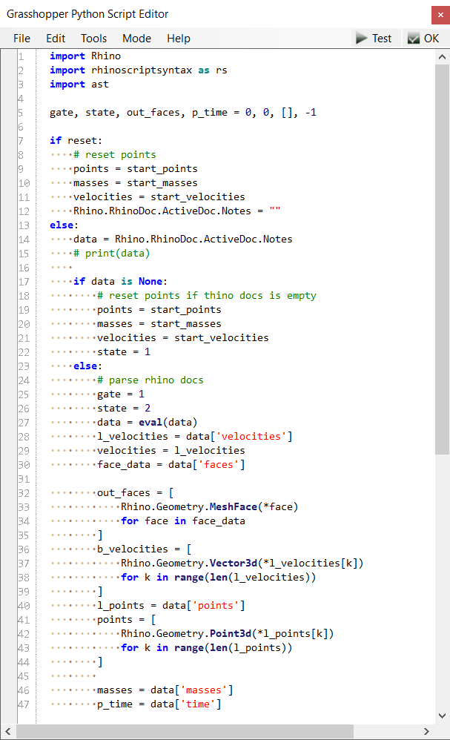
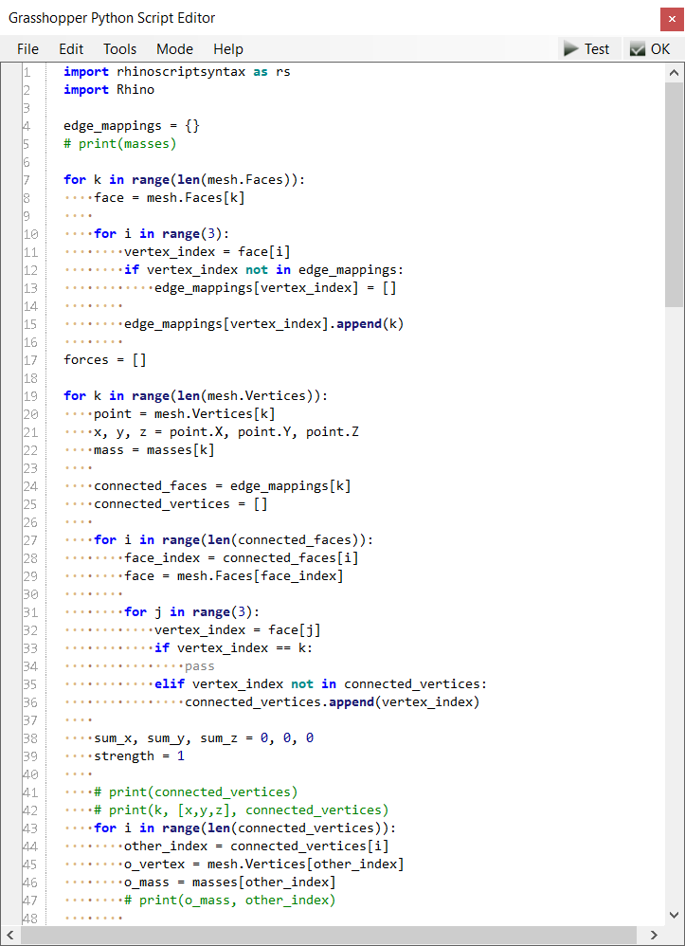
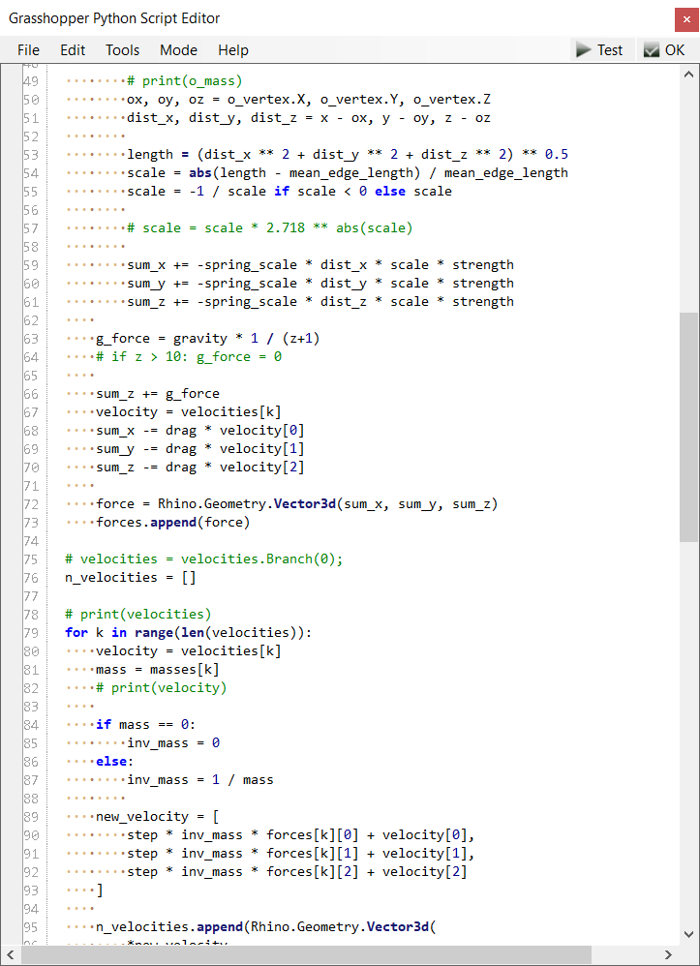
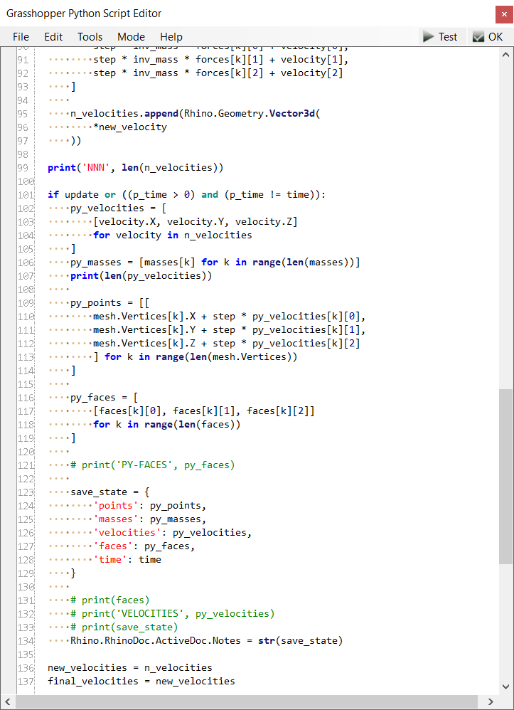
P#
<Computational Design Thinking>
<Generative Design>
P#
References
To ensure that the mesh looks regular, realistic, fully generated, interesting and consistent, several important changes have been made. First, code is being used to generate points of the initial mesh along rings of hexagons distributed along the radius of the outer-most hexagon. The outer most set of points are set to have mass 0.
The mesh is also generated using Delaunay triangulation, which produces triangular rather than rectangular mesh faces, and avoids creating tiny faces. In this case, triangular faces ensure the mesh looks less like a blanket flopping up and more like an actual deliberately designed inflating structure.
Spikes are generated by connecting faces to the normal vector of each face from its center, scaled by the mean length of the edges of the respective face.
Code from assignment 2 was used to generate the terrain, and z-coordinate of initial mesh points are aligned with terrain.
Delaunay triangulation https://sudonull.com/post/6026-The-math-in-Gamedev-is-simple-Triangulation-and-TriangleNet-in-Unity
“make spikes” cluster
“make terrain” cluster
“load and integrate” code
“calculate…” code – integrates positions, velocities and saves state to rhino docs
Captions
01 code
01

Slide 3
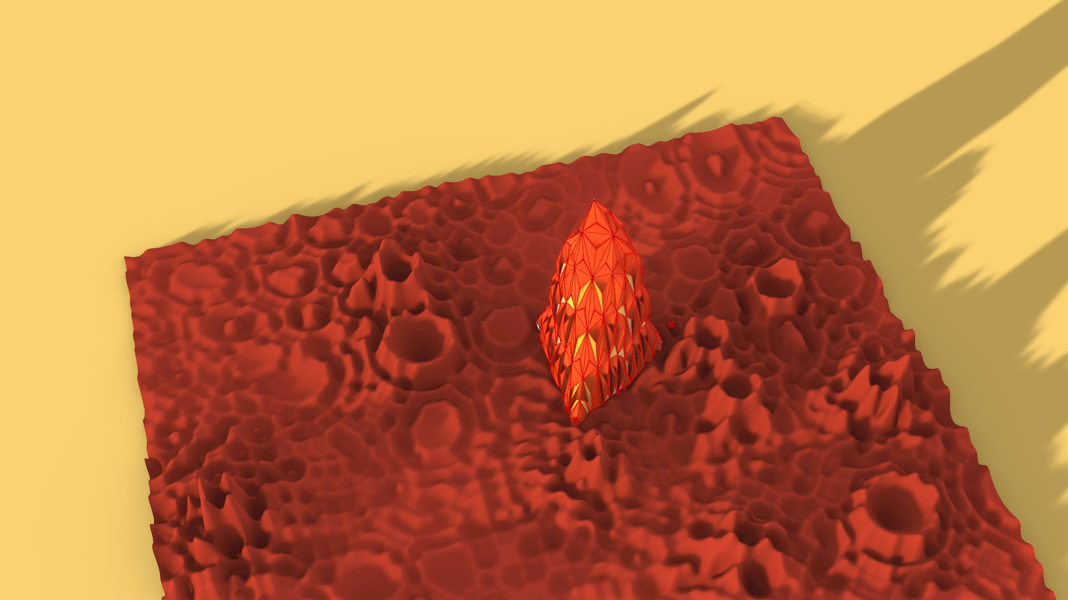
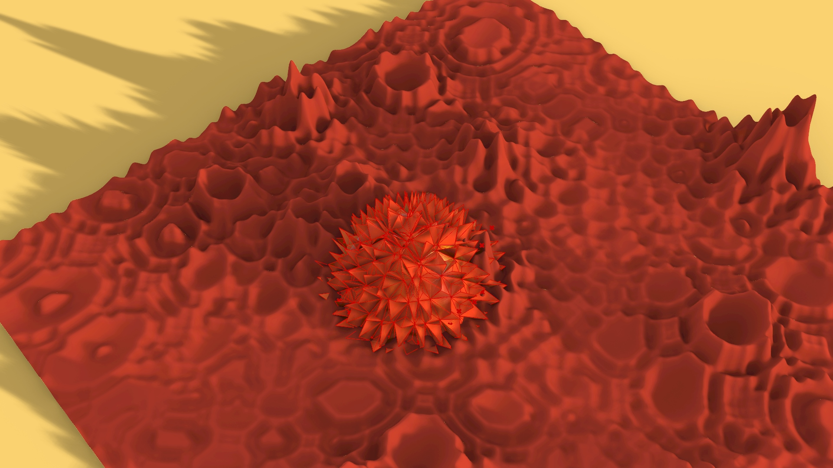
P#
<Computational Design Thinking>
<Generative Design>
P#
Captions
01 variation 1
02 variation 2
01
02

Slide 4
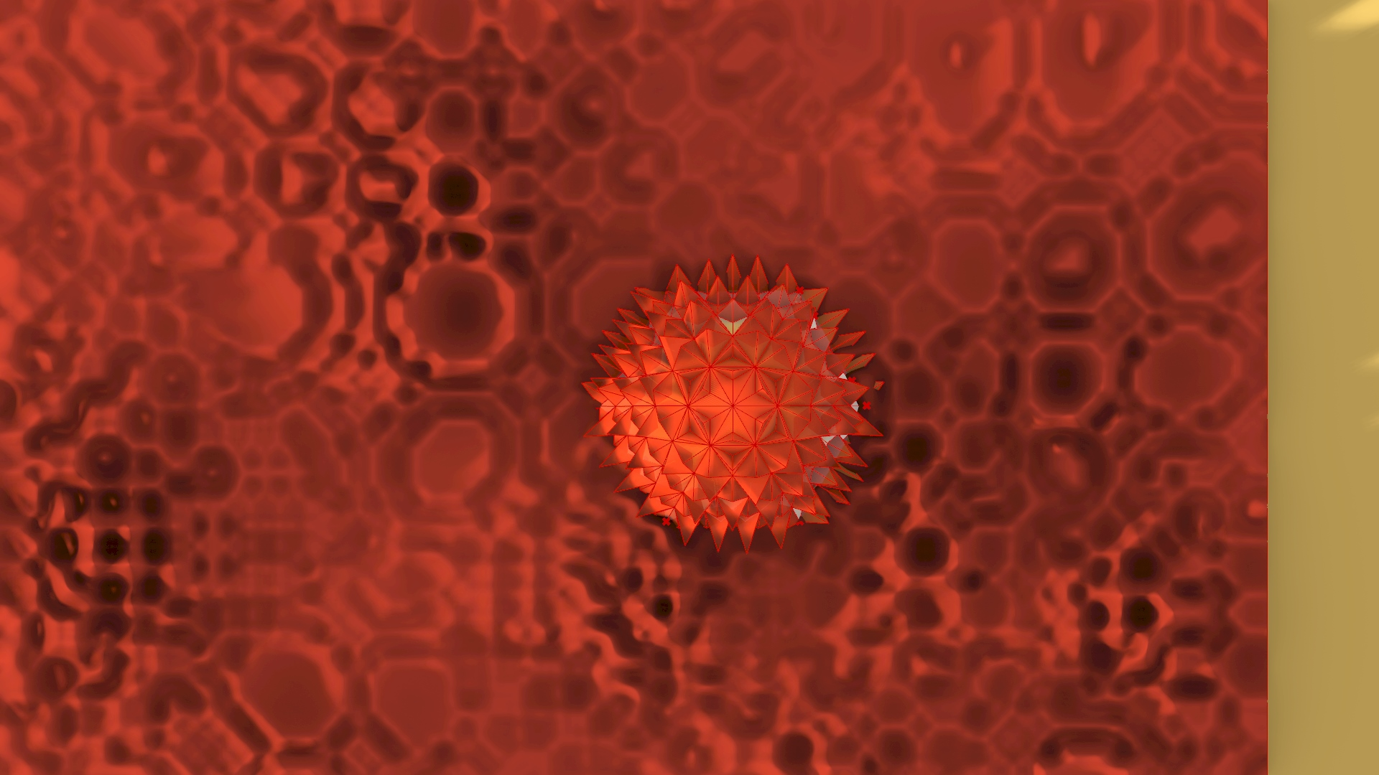
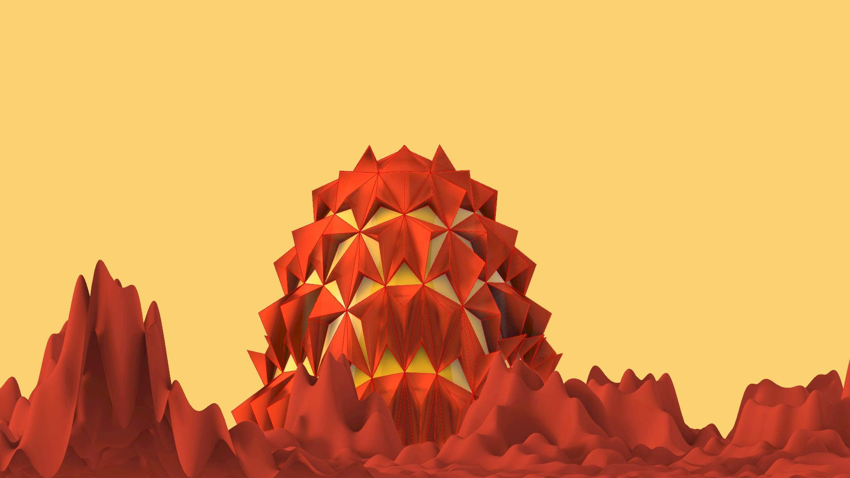
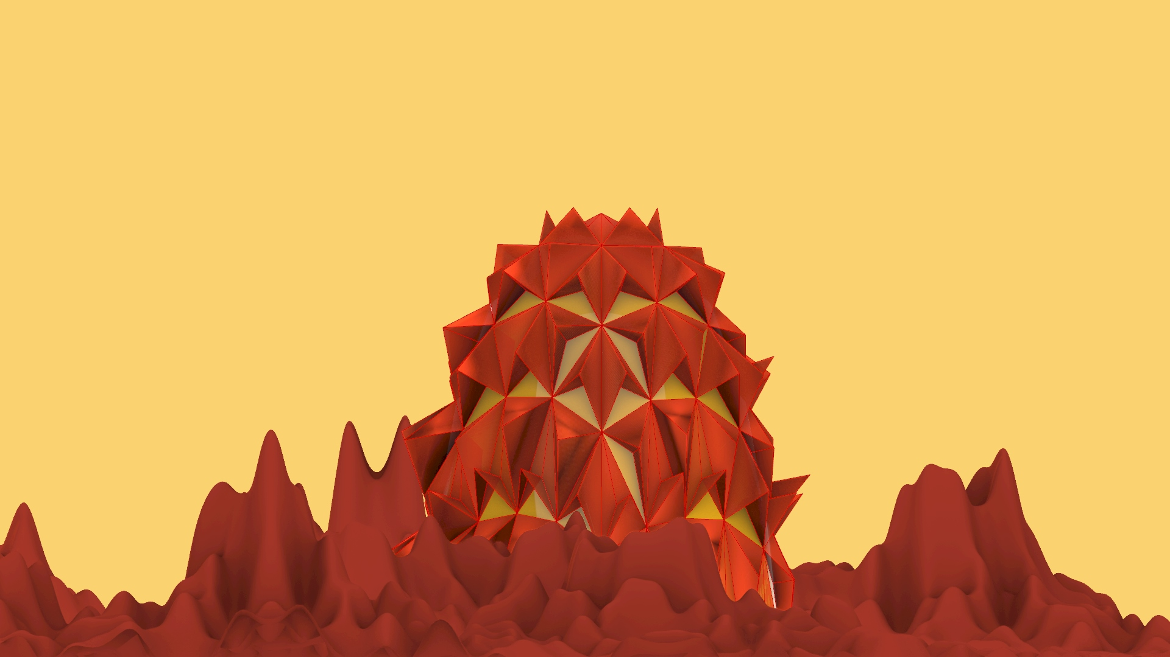
P#
<Computational Design Thinking>
<Generative Design>
P#
4/4
1/2
1/2
Captions
01 top view
02 front view
03 top view
01
02
03

Slide 5
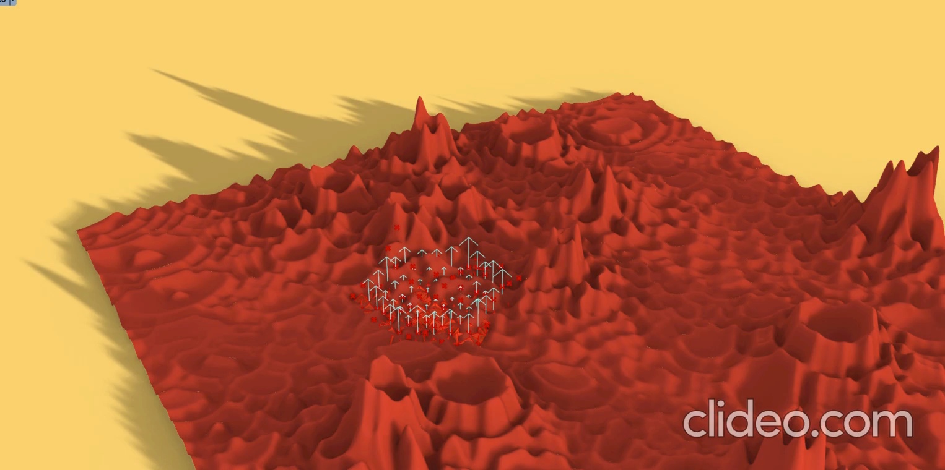
P#
<Computational Design Thinking>
<Generative Design>
P#
Captions
01 video
01

